Slide 1
Spark Framework

Slide 2
Hadoop - MapReduce
Read the data from stable storage and write the output to stable storage
Map
Reduce
Input
Map
Output
Reduce
Map
Notes:
Also applies to Dryad, SQL, etc
Benefits: easy to do fault tolerance and

Slide 3
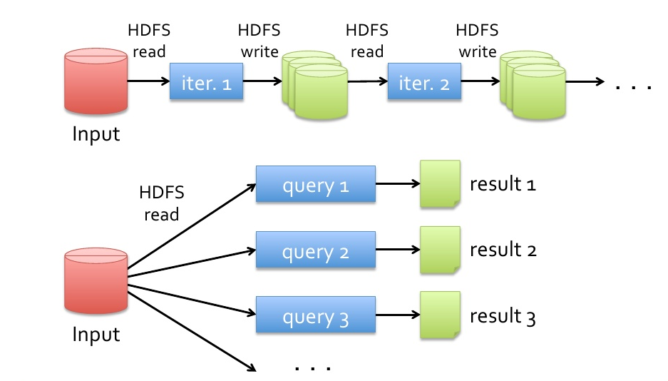
Data Processing - Hadoop

Slide 4
Spark Framework
In-Memory Cluster Computing for
Iterative and Interactive Applications

Slide 5
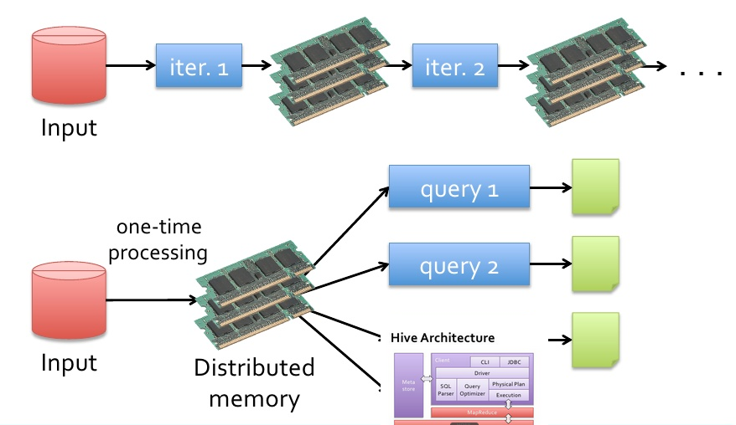
Data sharing - spark

Slide 6
Key Features of SPARK - Easy to Use
Simpler programming model
Easy to develop
80-plus data processing operators vs Just two (Map and Reduce).
10 Lines of code instead 50 lines

Slide 7
Key Features of SPARK - Fast
100 times Faster than Hadoop if fits in memory else 10 times faster.
Two reason
in memory computation
Advanced job execution engine
Convert a job into a directed acyclic graph (DAG) of stages.
DAG in spark can contain any number of stages.
It minimizes disk I/O and data shuffles, which involves data movement across a network and increases application execution time.

Slide 8
Understanding Spark
The Big data Platform
Scales to peta bytes of data
MapReduce: Batch orient Compute

Slide 9
Spark Components

Slide 10
Spark libraries
SparkSQL: provides SQL-like ability to interrogate structured data and interactively explore large datasets
SparkMLLIB: provides major algorithms and a pipeline framework for machine learning
Spark Streaming: provides real-time analysis of data using micro batches and sliding widows on incoming streams of data
Spark GraphX: Used for graph processing and computation on complex connected entities and relationships

Slide 11
Spark Goal
Provide distributed memory abstractions for clusters to support apps with working sets
Retain the attractive properties of MapReduce:
Fault tolerance (for crashes & stragglers)
Data locality
Scalability
Solution: augment data flow model with “resilient distributed datasets” (RDDs)
Notes:
RDDs = first-class way to manipulate and persist intermediate datasets

Slide 12
RDD – Resilient Distributed Datasets
Allow apps to keep working sets in memory for efficient reuse
Resilient – Fault tolerant (Recover)
Distributed – Across machine (Partitioned)
Dataset – Collection of Records (immutable)
Ie: Read only partitioned collection of records
Support a wide range of application

Slide 13
Laziness in Programming
Means not computing the transformation till its needed.
Separates execution from evaluation.
Example
A = 100
B = 100
C = A * B
C = 10
Print C

Slide 14
RDD Fault Tolerance
RDDs maintain lineage information that can be used to reconstruct lost partitions
A = 100
B = 100
C = A * B
Print C
D = C * 100
Print D
Lineage : D → C * 100 → C → A * B

Slide 15
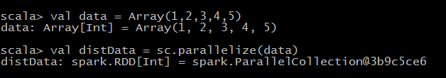
RDD Types: parallelized collections
By calling SparkContext’s parallelize method on an existing Scala collection (a Seq obj)
Once created, the distributed dataset can be operated on in parallel

Slide 16
Immutability
Once created it never changes.
Big data by default is immutable.
Helps to
Parallelize
Caching
Example
const int a = 0 // immutable
int b =0 // mutable

Slide 17
RDD Operations
Transformations (define a new RDD)
map filter sample union groupByKey reduceByKey join cache …
Parallel operations (return a result to driver)
reduce collect count save lookupKey …

Slide 18
Installation
Install SCALA
Download Spark 1.X / Spark 2.x / source code
bin/spark-shell

Slide 19
The Spark Shell
Spark supports writing programs interactively using either the Scala or Python REPL
Read-Eval-Print-Loop, or interactive shell.
The shell provides instant feedback as we enter code, as this code is immediately evaluated.

Slide 20
First Program
cd /usr/local/spark
IPYTHON=1 ./bin/pyspark
PYSPARK_DRIVER_PYTHON=ipython PYSPARK_DRIVER_PYTHON_OPTS="--pylab" ./bin/pyspark
from pyspark import SparkContext
sc=SparkContext("local[2]","First App")
Data = [1, 2, 3, 4, 5]
# Create the RDD by parallelizing the collection
distData=sc.parallelize (Data)
distData.collect()
Output: [1, 2, 3, 4, 5]

Slide 21
collection = ['a','b','c','d','e']
rddFromCollection = sc.parallelize(collection) rddFromCollection.collect()
Output: ['a', 'b', 'c', 'd', 'e']
rddFromTextFile=sc.textFile("/home/ponny/a.txt")
rddFromTextFile.collect()
Output: [`big data analytics’]

Slide 22
RDD Operation
Transformation
Create a new dataset from a dataset
Lazy operation
Operates when an action is run on it
Eg: map, filter, flat map etc
Actions
Compute values
Return values or write O/P to external storage
Earlier transformations are applied to RDD
Since transformations are lazy operation
Eg: Collect, Count, For Each, top, reduce etc

Slide 23
Action – Collect ()
Collect to retrieve the entire RDD In the Driver (Spark Context – SC)
Should be used for smaller RDDs
For larger RDDs, we should write to distributed Storage

Slide 24
Action – Take ()
Take (n) : Returns n elements from RDD
Number from any partition of RDD
Eg: distData.take(3)
Output : [1,2,3]

Slide 25
Action – TOP (n)
top (n) : Top n elements from RDD using default ordering
distData.top(2)
Ans [5, 4]

Slide 26
Action – First ()
Return first element in the RDD
distData.first()
Output : [1]

Slide 27
Action – Count()
Return number of elements in the current RDD
distData.count()
Output : [5]

Slide 28
Action – Reduce ()
Reduce the same data type values
distData.reduce(lambda x,y:x+y)
Output : [15] : → 1 + 2 = 3
3+3 = 6
6+4 = 10
10+5 = 15

Slide 29
Action - foreach
Takes a method for executing each element in in RDD.
Output
('spark', 1)
('spark', 2)
('spark', 3)
('spark', 4)
('spark', 5)

Slide 30
Transformation – Map()
Takes a function and applies to each element in the RDD.
mappedData=distData.map(lambda x:x*x)
mappedData.collect()
Output : [1, 4, 9, 16, 25]

Slide 31
Transformation – Filter
Filter based on condition
filteredData=distData.filter(lambda i:i%2==0)
filteredData.collect()
Output : [2, 4]

Slide 32
Transformation – flatmap ()
distData.map(lambda x:[x,x+5]).collect()
Output : [[1, 6], [2, 7], [3, 8], [4, 9], [5, 10]]
distData.flatMap(lambda x:[x,x+5]).collect()
Output: [1, 6, 2, 7, 3, 8, 4, 9, 5, 10]

Slide 33
# To collect Keys alone
m = sc.parallelize([('Apple', 1), ('Orange',2), ('Apple',5)]).keys()
m.collect()
Output : ['Apple', 'Orange', 'Apple']
# To collect values alone
m = sc.parallelize([('Apple', 1), ('Orange',2), ('Apple',5)]).values()
m.collect()
Output : [1, 2, 5]

Slide 34
Key-Value Transformations
m = sc.parallelize([('Apple', 1), ('Orange',2), ('Apple',5)])
d=m.reduceByKey(lambda x,y:x+y)
d.collect()
Output : [('Orange', 2), ('Apple', 6)]

Slide 35
sortByKey
To collect the RDD in ascending / descending order
tmp = [('a', 1), ('b', 2), ('1', 3), ('d', 4), ('2', 5)]
sc.parallelize(tmp).sortByKey().collect()
Output : [('1', 3), ('2', 5), ('a', 1), ('b', 2), ('d', 4)]
sc.parallelize(tmp).sortByKey(False).collect()
Output : [('d', 4), ('b', 2), ('a', 1), ('2', 5), ('1', 3)]

Slide 36
Word Count
a=sc.textFile("/home/ponny/a.txt")
Big Data Analytics
words= a.flatMap(lambda x:x.split())
word_count=(words.map(lambda x:(x,1)).reduceByKey(lambda x,y:x+y))
Output [ (‘Analytics 1’)(‘Big’ 1) (‘Data’ 1)]

